Slide 1
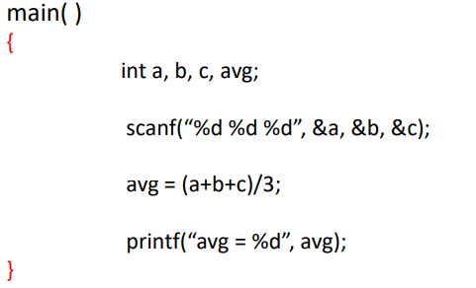

Slide 2
n1=12, N1=27
n2= 7, N2=15

Slide 3
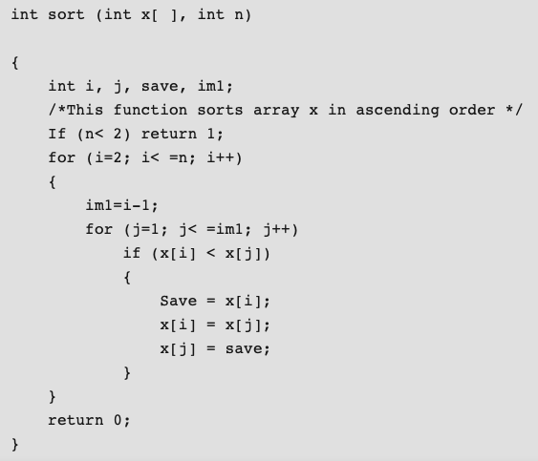

Slide 4
Operators | Occurrences | Operands | Occurrences
int | 4 | sort | 1
() | 5 | x | 7
, | 4 | n | 3
[] | 7 | i | 8
if | 2 | j | 7
< | 2 | save | 3
; | 11 | im1 | 3
for | 2 | 2 | 2
= | 6 | 1 | 3
– | 1 | 0 | 1
<= | 2 | – | –
++ | 2 | – | –
return | 2 | – | –
{} | 3 | – | –
n1=14 | N1=53 | n2=10 | N2=38

Slide 5
Therefore, N = 91 n = 24 V = 417.23 bits N^ = 86.51 n2* = 3 (x: array holding integer to be sorted. This is used both as input and output) V* = 11.6 L = 0.027 D = 37.03 L^ = 0.038 T = 610 seconds

Slide 6
Exercise
void sort( int *a, int n )
{
int i, j, t;
if ( n <2 )
return;
for( i=0 ; i < n-1; i++)
{
for( j=i+ 1 ; j < n ; j++)
{
if ( a[i] > a[ j] )
{
t = a[ i] ;
a[ i] =a[ j] ;
a[ j] = t;
}}}}

Slide 7
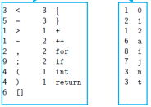
Operator= 18, Count= 51
Operand = 8, Count=32

